Slide 1
VF Live Migration on E810
Intel Network Technical Summit
Powered by 4th Gen Intel® Xeon® Scalable Processor
Yahui Cao, Lingyu Liu, Yi Sun
Notes:
《基于E810网卡的VF热迁移---依托第四代Xeon可扩展处理器的加速案例》

Slide 2
Notices and Disclaimers
Results have been estimated or simulated.
Performance varies by use, configuration and other factors. Learn more at www.Intel.com/PerformanceIndex​.
Performance results are based on testing as of dates shown in configurations and may not reflect all publicly available ​updates. See backup for configuration details. No product or component can be absolutely secure.
Your costs and results may vary.
Intel technologies may require enabled hardware, software or service activation.
All product plans and roadmaps are subject to change without notice.
Code names are used by Intel to identify products, technologies, or services that are in development and not publicly available. These a​​re not "commercial" names and not intended to function as trademarks.​​
Intel contributes to the development of benchmarks by participating in, sponsoring, and/or contributing technical support to various benchmarking groups, including the BenchmarkXPRT Development Community administered by Principled Technologies.
Availability of accelerators varies depending on SKU. Visit the Intel Product Specifications page for additional product details.
© Intel Corporation. Intel, the Intel logo, and other Intel marks are trademarks of Intel Corporation or its subsidiaries. Other names and brands may be claimed as the property of others. ​
Notes:
Add Notices and Disclaimers slide/section
Performance varies by use, configuration and other factors. Learn more at www.Intel.com/PerformanceIndex.
Performance results are based on testing as of dates shown in configurations and may not reflect all publicly available updates. See backup for configuration details. No product or component can be absolutely secure.
Your costs and results may vary.
Intel technologies may require enabled hardware, software or service activation.
© Intel Corporation. Intel, the Intel logo, and other Intel marks are trademarks of Intel Corporation or its subsidiaries. Other names and brands may be claimed as the property of others.

Slide 3
Agenda
Overview
E810 Live Migration
4th Gen Intel® Xeon® Scalable Processor Offloads Dirty Page Tracking
Use case & Benchmark
Notes:
Ensure document is marked at bottom of page with the right usage guideline:
NDA: "Intel Confidential - NDA Use Only"
Public: No marking
Disclaimers:
For every slide with performance claim, does it have “See backup for workloads and configurations. Results may vary.”
If you have cost/TCO info on the slide, add pricing info (break out key components – system, power cost, infra, software, etc), source, as of date - as part of the configuration
Add this info on a separate slide or at the end of the white paper as part of the footnotes
For every word, such as of higher, better, lower, more, is there a numbered footnote that points to the backup to explain the source of this claim.

Slide 4
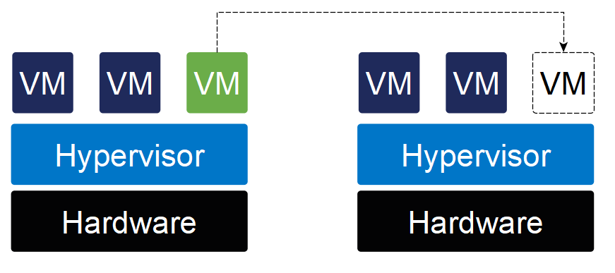
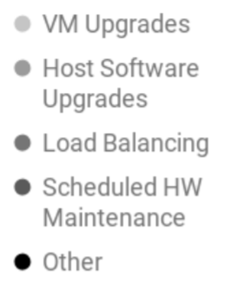
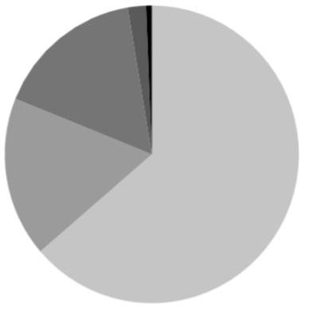
Overview
Live Migration: moving a running VM between different physical machines without disconnecting
Usage Some CSP did 1Milllion times migration monthly in production around 2017
Causes of migration for all production migrations Jan–March 2017 https://dl.acm.org/doi/pdf/10.1145/3186411.3186415
Notes:
Virtio
Failover, guest driver dependency(Linux failover) userspace driver(DPDK) not support.
Vfio migration, guest OS agnostic

Slide 5
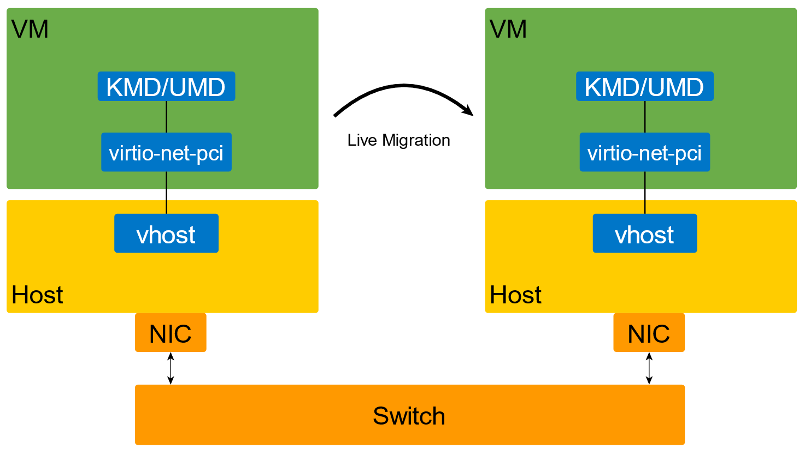
Overview
virtio migration
Notes:
Virtio
Failover, guest driver dependency(Linux failover) userspace driver(DPDK) not support.
Vfio migration, guest OS agnostic

Slide 6
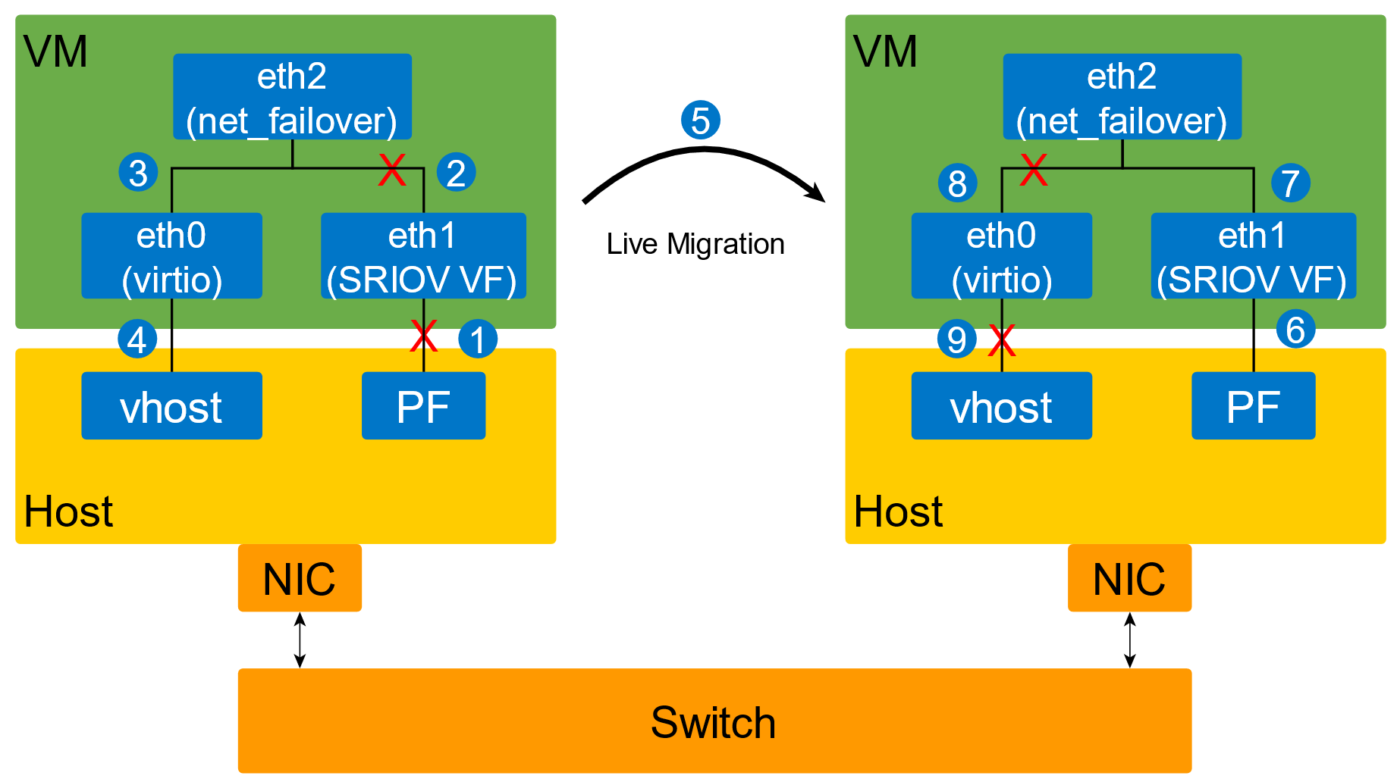
Overview
virtio migration
failover migration
Notes:
Virtio，优劣势
Failover, 优劣势，guest driver dependency(Linux failover) userspace driver(DPDK) not support.，
Vfio migration, 优劣势，guest OS agnostic, performance, operation

Slide 7
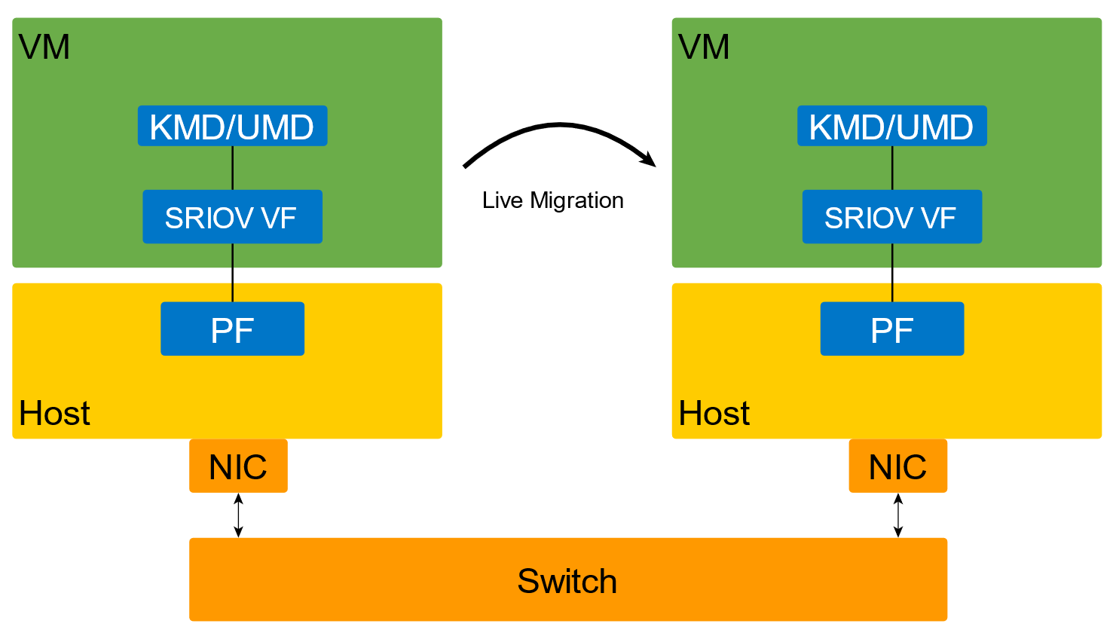
Overview
virtio migration
failover migration
vf migration
Notes:
Virtio
Failover, guest driver dependency(Linux failover) userspace driver(DPDK) not support.
Vfio migration, guest OS agnostic

Slide 8
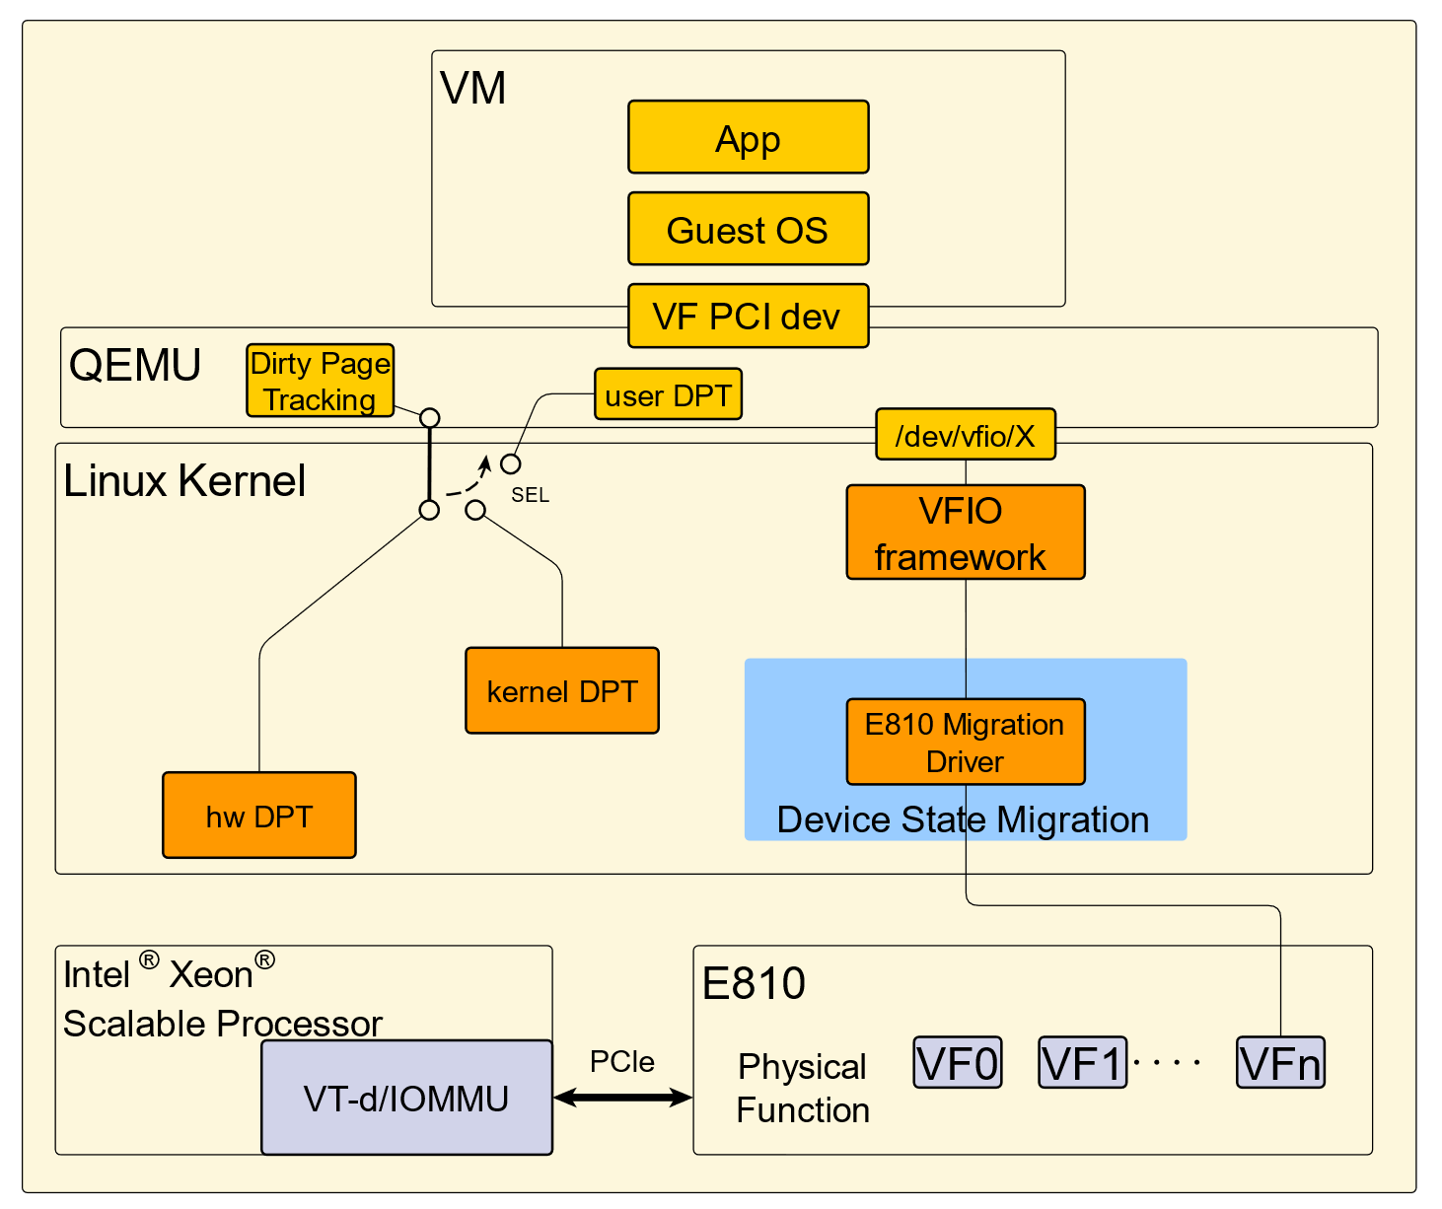
E810 Live migration architecture
Device State
VFIO framework based
Dirty Page Tracking
user/kernel/hw

Slide 9
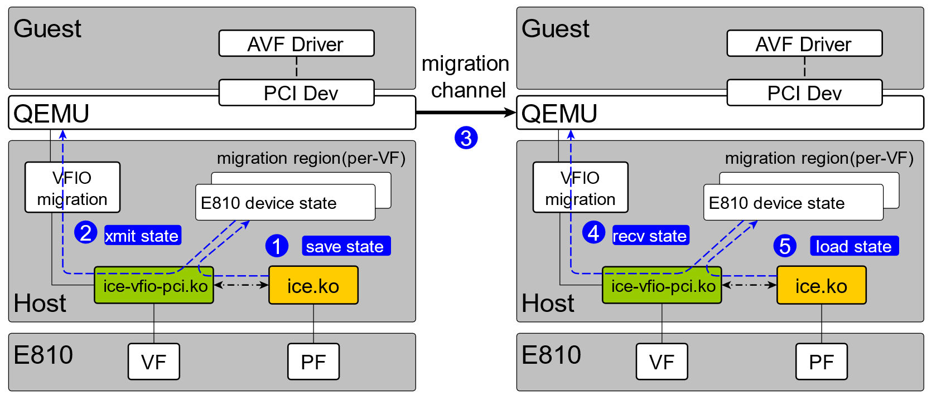
E810 Live migration: Device state
Device State
DMA ring
PCI CSR/MMIO
Pipeline
…
Notes:
Put picture to transfer device from source side to destination side.

Slide 10
E810 Live migration: Dirty Page Tracking
Dirty Page Tracking(DPT)
What & Why
user DPT: sync all Guest mem
kernel DPT: dev-specific
HW DPT: platform offload
DMA bypass QEMU
Notes:
Dirty pages intro and why DPT(passthrough, bypass hypervisor)
Why 4th Xeon and A/D bits. Put picture about A/D bits
ICX platform, optional SW based DPT.

Slide 11
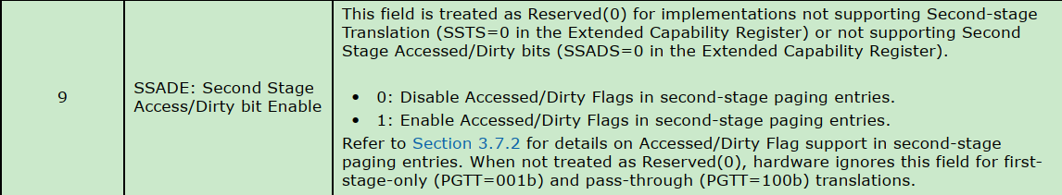
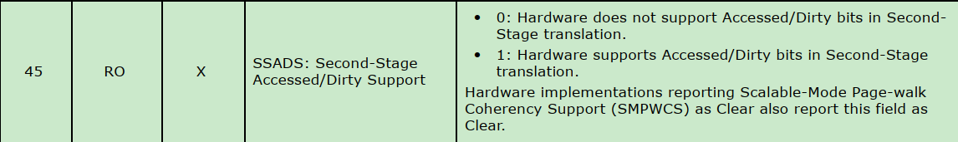
4th Gen Intel® Xeon® Scalable Processor Offloads Dirty Page Tracking
Integrate new IOMMU
Support SSAD
SSAD
What
Why
Second-stage paging entry
Scalable-mode pasid entry
Extended capability register
https://www.intel.com/content/www/us/en/content-details/774206/intel-virtualization-technology-for-directed-i-o-architecture-specification.html
Notes:
Dirty pages intro and why DPT(passthrough, bypass hypervisor)
Why 4th Xeon and A/D bits. Put picture about A/D bits
ICX platform, optional SW based DPT.

Slide 12
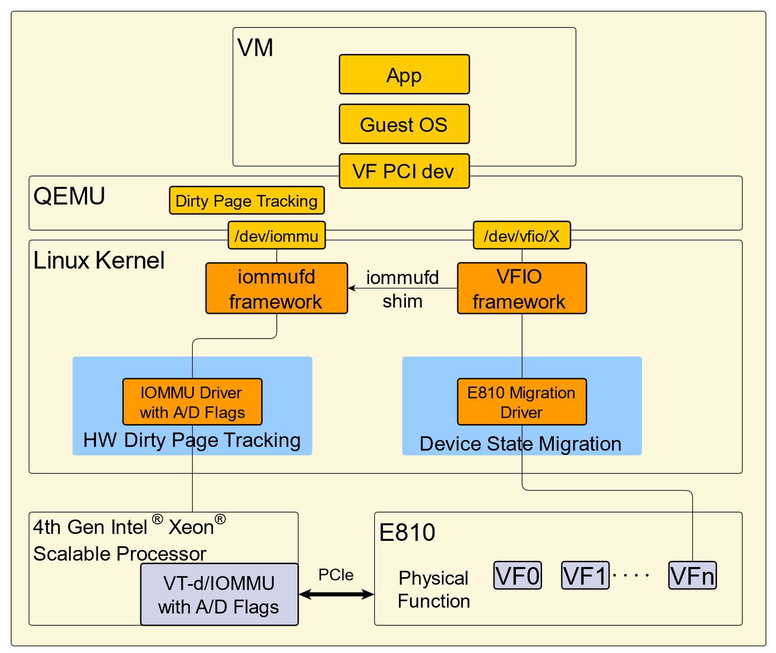
4th Gen Intel® Xeon® Scalable Processor Offloads Dirty Page Tracking
Migration flow
Qemu starts/stops dirty logging
Qemu gets device dirty bitmap through iommufd to migrate ram
Qemu changes VF migration status and stops VF
Qemu gets VF states and migrate them
Dirty page tracking

Slide 13
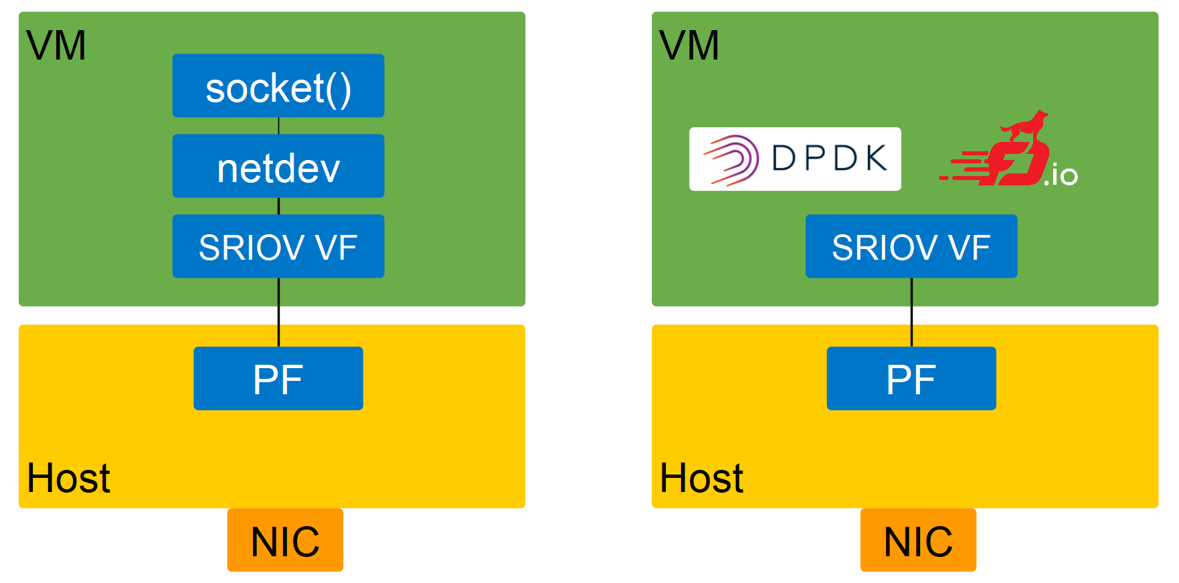
Use case & Benchmark
Notes:
Driver/OS agnostic

Slide 14
Use case & Benchmark
Network downtime
HW DPT reduces 80%-96% network down time.
Performance Downgrade
No performance downgrade @20Mpps
(Performance varies by use, configuration and other factors.
See backup for workloads and configurations. Results may vary)
Notes:
Netdev
DPDK/VPP
Baseline: 1-node, 2xIntel(R) Xeon(R) Platinum 8480CL on Intel Corporation ArcherCity with 2x16GB DDR5 4800 MT/s[4800 MT/s] total DDR5 memory, microcode 0x2a0000a0, HT disabled, Turbo Enabled, Fedora Linux 36, 6.2.0-rc8-intel-next+, 1x372.6G Intel SSD, ping from iputils 20211215, iperf version 2.1.8, GCC 12.2.1, test by Intel on Mar 2023.

Slide 15
Key Takeaway
VF Migration is a balance between compatibility & perf
E810 Live Migration consists of Device State & DPT
4th Gen Intel® Xeon® Scalable Processor accelerates downtime w/o perf degrade
 | Device State | Dirty Page Tracking
4th Gen Intel® Xeon® Scalable Processor | Migration Driver | HW DPT
Non-4th Xeon | Migration Driver | dev-specific DPT
Notes:
Netdev
DPDK/VPP

Slide 16
Notes:
Q&A:
Is E810 live migration supported on icx ?
A/D is supported on all of 4th Xeon ? For ICX, how to process DPT ?
Solution upstreamed or not ?

Slide 17
System configuration(Back up)
1-node, 2xIntel(R) Xeon(R) Platinum 8480CL on Intel Corporation ArcherCity with 2x16GB DDR5 4800 MT/s[4800 MT/s] total DDR5 memory, microcode 0x2a0000a0, HT disabled, Turbo Enabled, Fedora Linux 36, 6.2.0-rc8-intel-next+, 1x372.6G Intel SSD, 4x Ethernet Controller E810-C for SFP, 1x Ethernet Controller I225-LM, 2x Ethernet Controller E810-XXV for SFP, 1x Ethernet Controller E810-C for QSFP
ping from iputils 20211215, iperf version 2.1.8, GCC 12.2.1, qemu-next 1 core for each VM, VM memory size varies from 1G to 8G, Ping sends 1000 packets per second, test by Intel on Mar 2023.

Slide 18
Throughput downgrade(Back up)
throughput downgrade if HW dirty
page track enables after migration begins
4th Gen Intel Xeon Scalable Processor | Throughput downgrade test
Enable HW DPT | pps before migration | pps during migration
 | 8M | 8M
 | 15.5M | 15.5M
 | 17M | 17M
 | 20M | 20M

